Slide 1
Spring Conference #wpwvcSP15
@wpwvcacrl
Contact Us:
wpwvcacrlwebcommittee@gmail.com

Slide 2
Our Team
Jessa Darwin, Penn State Greater Allegheny
Twitter Manager
Kelly Bradish, University of Pittsburgh Greensburg
Dominique Luster, University of Pittsburgh iSchool
Amy Melnyk, University of Pittsburgh iSchool
Gesina Phillips, University of Pittsburgh iSchool

Slide 3
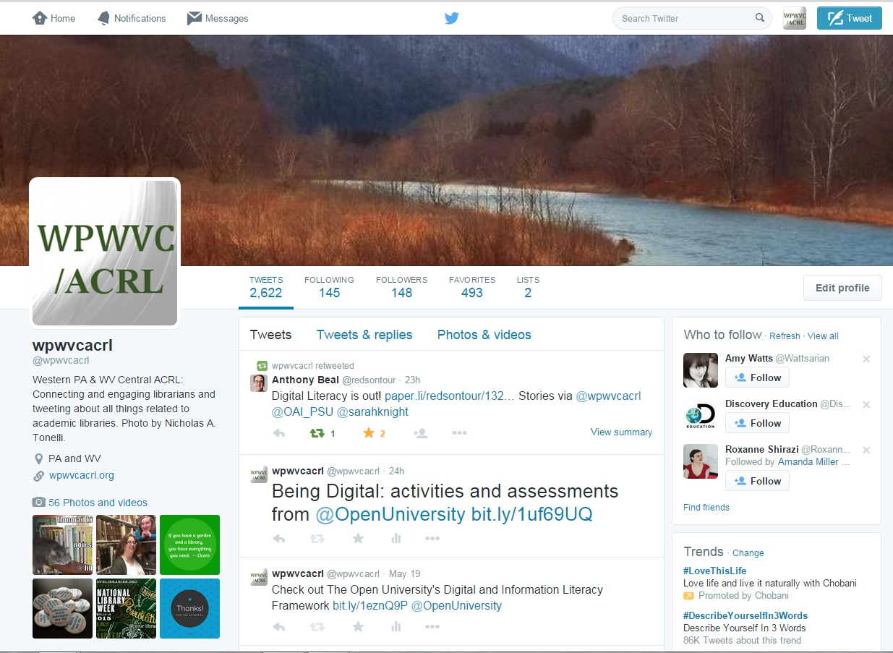
Our Mission

Slide 4
Our Interests
Connecting with colleagues across the US and around the World
Participating in Library-Related Chats
#inaljchat, #critlib, #libchat, and MORE!
Conferences, Meetings, Workshops, and other Professional Development Events
Job Opportunities in PA and WV
News, Programming, and Special Projects of our Affiliated Institutions
(We love your photos!)
Latest News, Books, Blogs, etc.

Slide 5
Follow Us
Have a Twitter account?
Follow us @wpwvcacrl
Tweet about the Spring Conference #wpwvcSP15
Don’t Have a Twitter Account?
Sign up for Free
Tweet When You Want
Can Make Your Account Private
Use Twitter Help to learn about hashtags, finding interesting people to follow, etc.

