Slide 1
How Does Your Graphic Novel Garden Grow? Harvesting the Benefits of Outreach and Collaboration
A Presentation by Amanda Miller
Public Services Librarian, Millstein Library
University of Pittsburgh at Greensburg
Contact Me! aem94@pitt.edu

Slide 2
Graphic Novel Collection: Part 1

Slide 3
Graphic Novel Collection: Part 1
Located on second floor
Not near any other stacks
Around a corner
Not much signage
Smaller collection in a big space
Not near other ‘leisure’ items

Slide 4
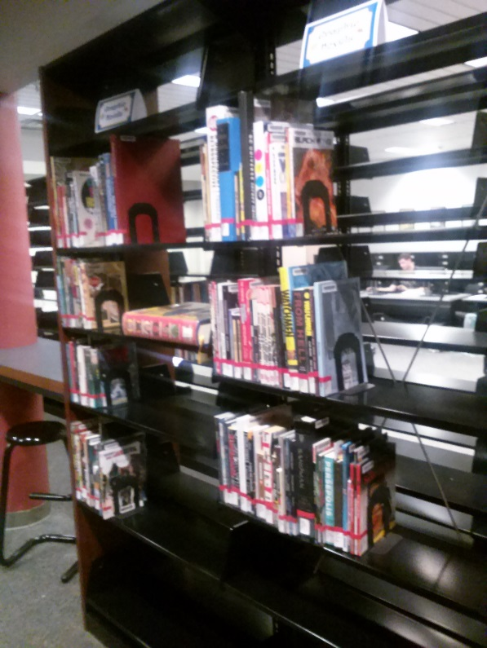
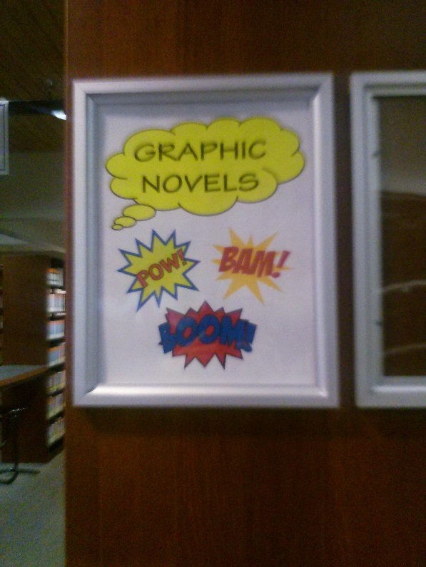
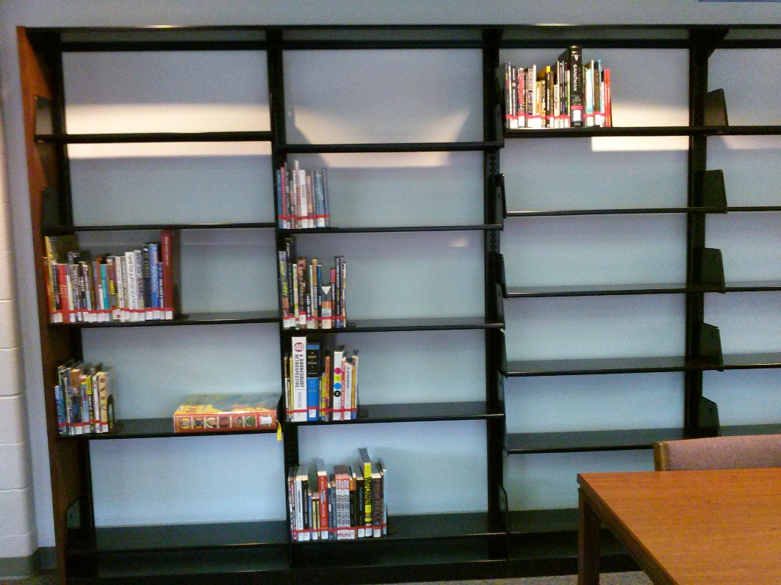
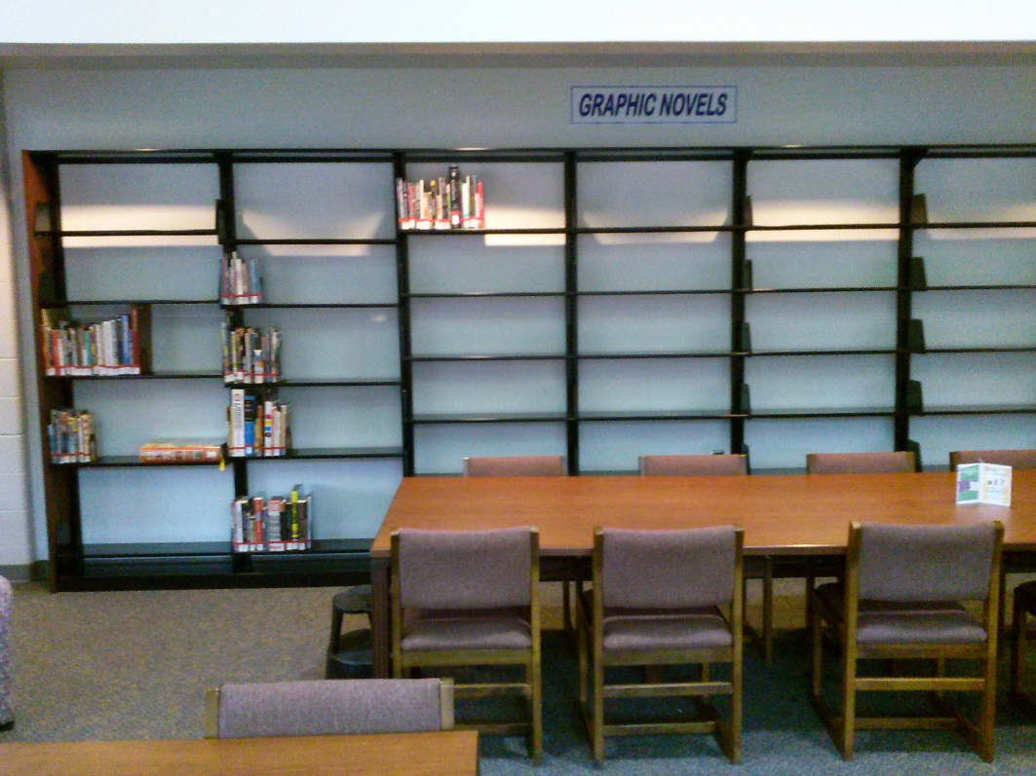
Graphic Novel Collection: Part 2

Slide 5
Collaboration with Nerdfighters
January 2015: reached out to Albert Thiel, Director of Student Activities
Utilized Facebook to alert Nerdfighters that there would be a survey
Created survey through University’s Qualtrics program
Left survey open until mid-February 2015
Closed survey to analyze responses of 9 participants
Multiple choice and open-ended survey questions included

Slide 6
Results of Nerdfighters Survey
Titles suggested by students
Manga: Fairy Tail, Death Note, Naruto, One Piece, Bleach, Black Butler
Graphic Novels: any sy-fy, more historical figures/events, Walking Dead series
Comic Book Collections: story arcs (eg. Batman: Killing Joke)
Miscellaneous: game guides or manuals

Slide 7
Collaboration with Joy’s Japanimation
March 2015: Contacted Steve Regina, owner of local comic book store “Joy’s Japanimation”
Found after researching Free Comic Book Day (May 2, 2015): “School & Library Partner”
Free comics delivered April 2015 and put out for students

Slide 8
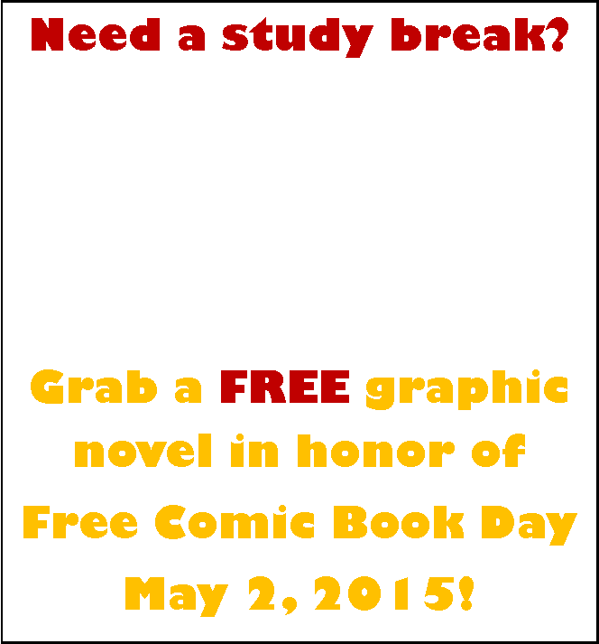
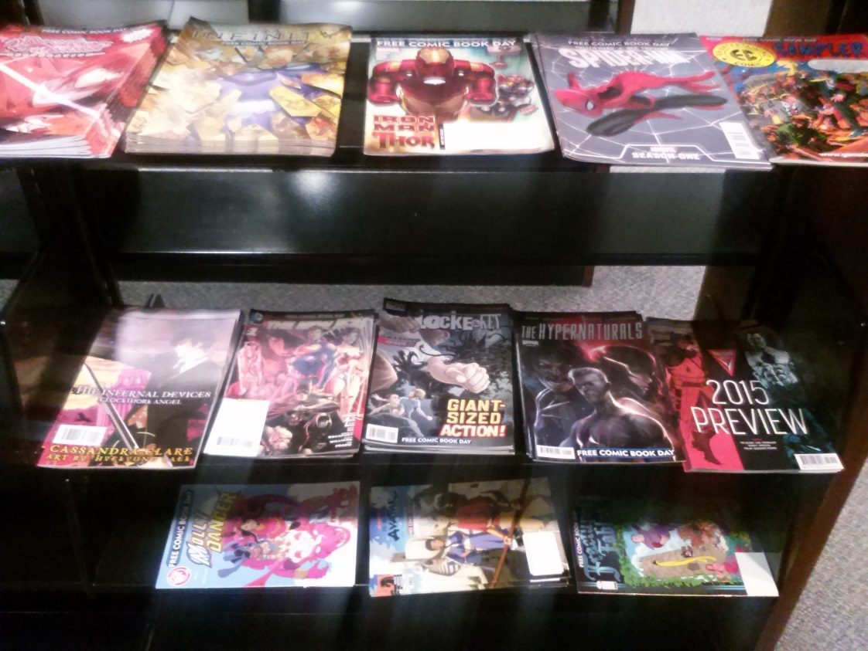
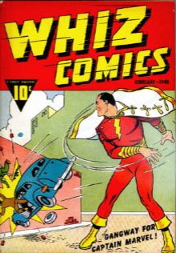
Free Comic Book Day!

Slide 9
Booklist Webinar + Outreach to DC
“Make Way for Manga, Comics, and Graphic Novels”
March 2015 Booklist Webinar
Reps from DC Entertainment, Viz Media, Udon, and Nobrow
1 hour discussion of upcoming titles
Emailed Blake Kobashigawa of DC Entertainment about a free book called DC Entertainment Essential Graphic Novels and Chronology 2015
Kit to also include posters and bookmarks for promotional use in libraries

Slide 10
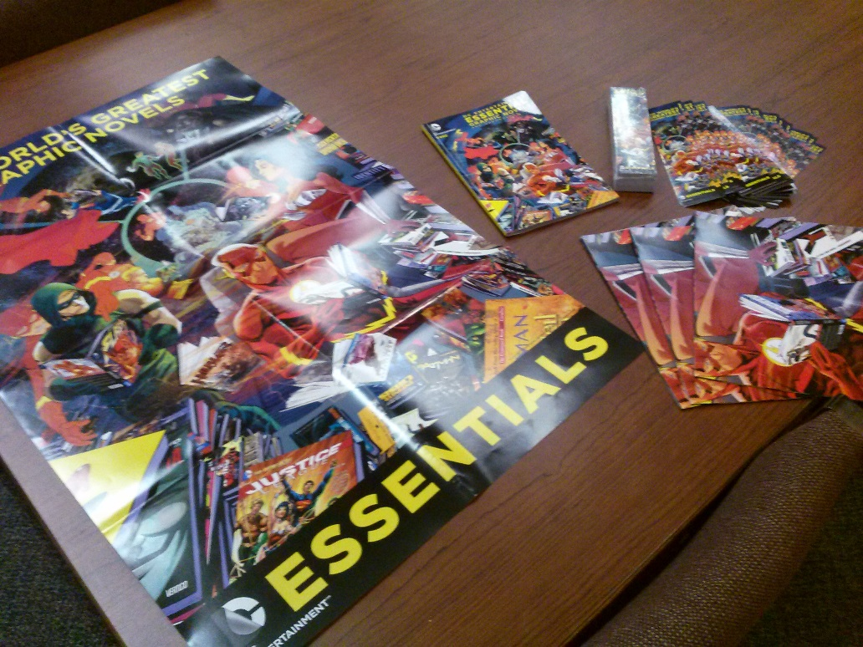
DC Entertainment Kit

Slide 11
Social Media Presence
Twitter
Instagram
Account to begin summer 2015
Ideas include:
Pictures of new titles that arrive
Fun with superheroes/villains!
Games

Slide 12
Collection Development
Library Journal reviews
Outreach with teachers
Hum/SocSci 300: War Zones, Urban Life, and the Graphic Novel
Englit 0626: Science Fiction
Englit 0066: Introduction to Social Literature
GoodReads “Listopia”
“Best of Marvel Comics”
“Novels to Graphic Novels/Manga Adaptations”
“Comics and Graphic Novels by Women”
“Marvel Comics 2014 Collected Editions Worth Reading”
DC, Marvel, Dark Horse, etc.
Looking at other libraries collections (eg. Columbia University Libraries)

