Slide 1
Sounding Board to Active Board: Maximizing a Student Advisory Board's Collaborative Effectiveness
Alyssa Archer, Beth Johnson, Craig Arthur and Candice Benjes-Small
McConnell Library, Radford University, Radford, VA
Notes:
Candice and Beth started the board in 2008. Currently Craig, Beth and myself are the librarians working with the advisory board.

Slide 2
Background
Radford University in Southwest Virginia
Public 4-year, some graduate programs
FTE < 10,000 students
McConnell Library Student Advisory Board
Between 8 and 12 members per semester
Application process
$50 stipend: 3 meetings, 2 special projects
Notes:
Most of the board members are library superusers, but we do try to find other voices, diverse range of backgrounds. It’s great, an opportunity to get to know some students really well, hear their perspectives in depth, rejuvenating, exciting, etc. Each of the 3 advisor librarians takes on one meeting per semester, helps to plan a guest speaker, business to attend to, and other activities.

Slide 3
The Problem
http://pixabay.com/en/education-a-good-idea-an-array-of-548105/
Notes:
We were getting a lot of really good ideas from our advisors, on changes that we should make to the library. However, someof these changes were impossible, either politically or logistically to enact. We needed to find ways to focus their scope on two channels: things that the library was in the midst of making decisions on that could benefit from their input, or on ideas that the advisors could enact themselves. We also needed concrete material that we could show to other library stakeholders to back up what we were hearing in our advisory meetings.

Slide 4
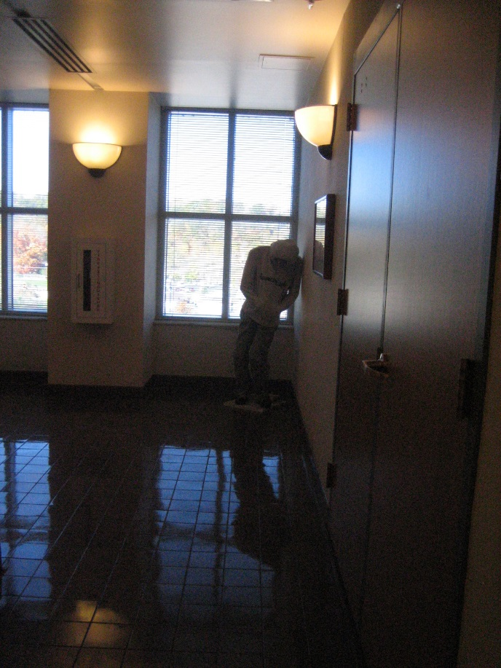
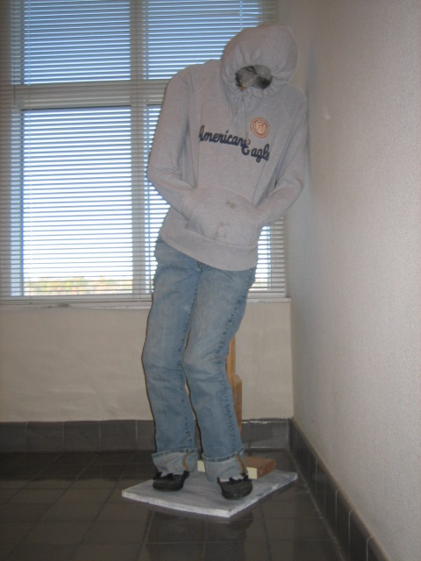
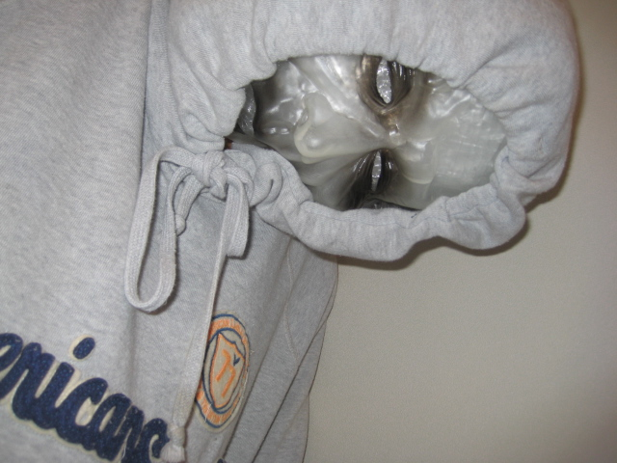
Experiments
Notes:
One of our first experiments in gaining more concrete information was to let them loose with iPods, taking pictures of what they liked and didn’t like in the library. When this sculpture showed up in 4 different student advisories shots of “don’t like”, helped start a conversation with the library’s curator of student art on a deselection policy.

Slide 5
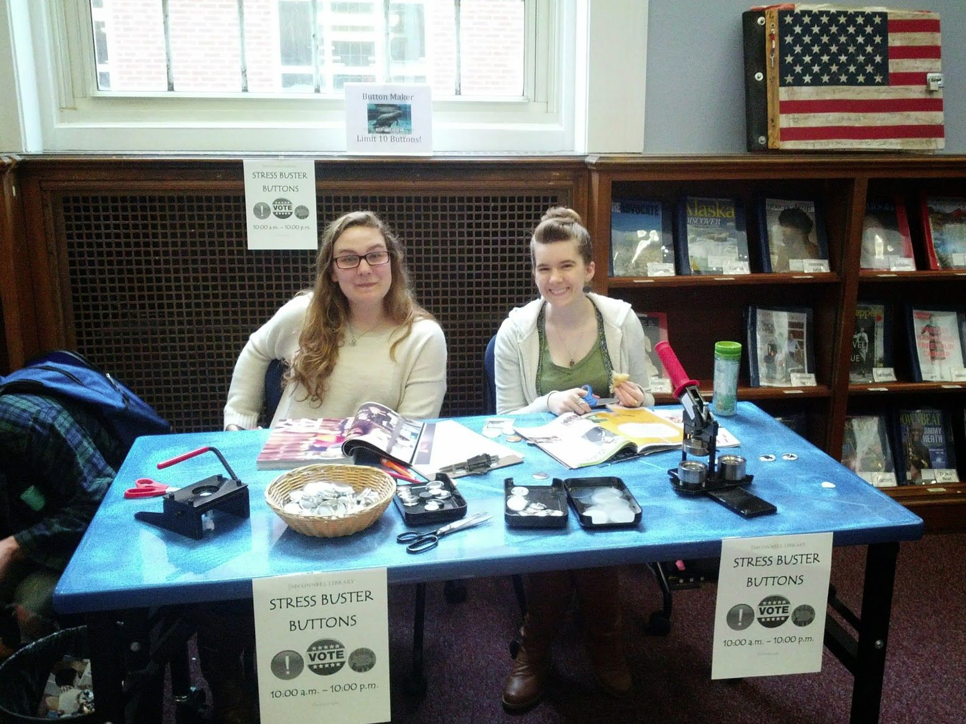
Collaborating with Departments
Archives & Technology – Feedback on interfaces
Technical Services – Choosing items for collection
Reference – Secret shopping desk
Instruction – Testing mobile library orientation game
Access Services – Surveying student workers, ILL
Notes:
However, this was a difficult conversation to start. We looked at areas where we had some leverage, and used the board to help our departments answer questions and solve problems. We offered the board’s services to assist with questions other departments were having. We began asking guest speakers to get our advisors feedback on an issue relevant to their field. Problems did come up: one example of an unsuccessful collaboration was when Technical Services asked the board to give feedback on the library’s Popular Periodicals collection. Our students were polite, but we were having a LOT of trouble getting them to give the feedback requested! It ended up with a conversation, in which most of the students admitted they didn’t understand what a popular periodical was, and they didn’t really have any opinion one way or another about magazines, since most didn’t read them. Lessons learned: don’t assume superusers know the jargon, and ask the right questions.

Slide 6
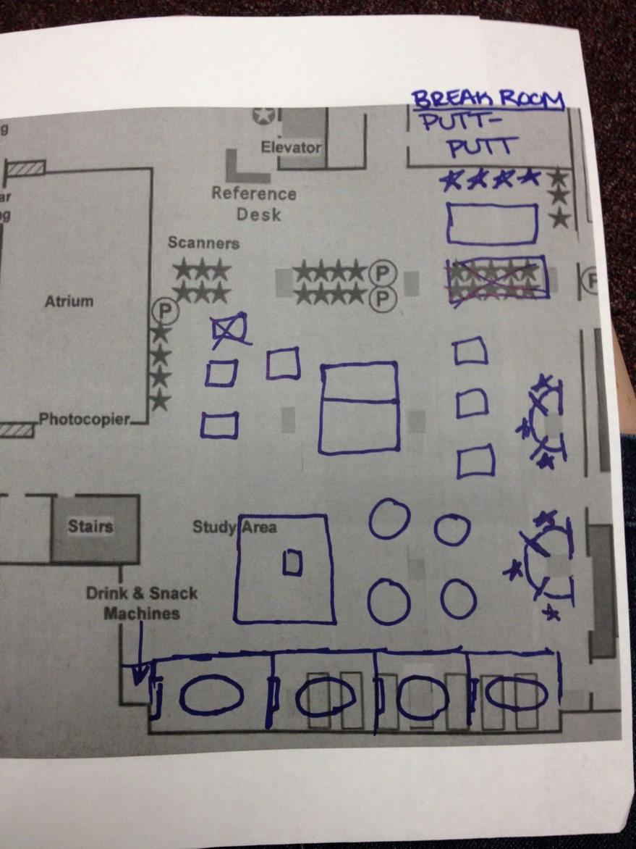
Ideas from the Literature
Foster, N. F., & Gibbons, S. (2007). Studying students: The Undergraduate Research Project at the University of Rochester. Chicago: Association of College and Research Libraries.
Notes:
We began exploring the literature, particularly related to ethnographies and user experiences research, for ideas to help harness our advisory group, taking the drawing what you’d like the space to look like exercise from the Rochester study…

Slide 7
Ideas from the Literature
Kocevar-Weidinger, E., Benjes-Small, C., Ackermann, E., & Kinman, V. R. (2010). Why and how to mystery shop your reference desk. Reference Services Review, 38(1), 28-43.
http://pixabay.com/en/road-sign-attention-right-of-way-63983/
Notes:
…to ideas that were home grown, like using the advisors to secret shop our Research Help Desk.

Slide 8
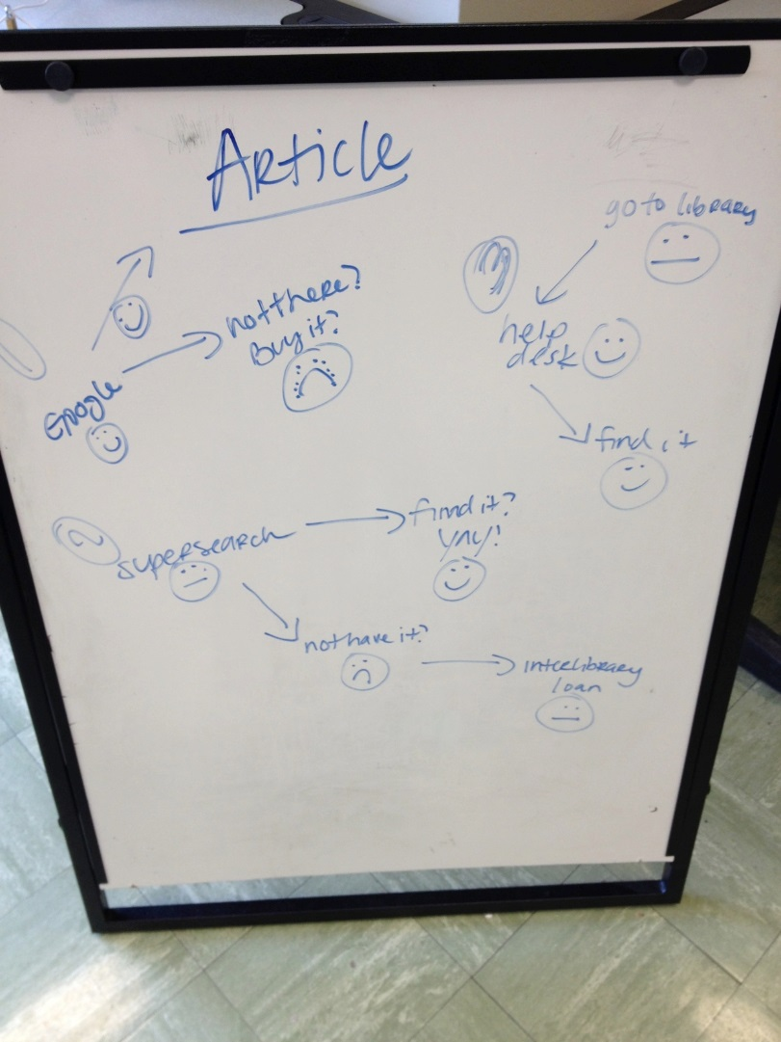
Ideas from the Literature
http://www.netpromoter.com/blogs/colin-shaw/2014/08/06/how-to-build-emotions-into-customer-journey-mapping

Slide 9
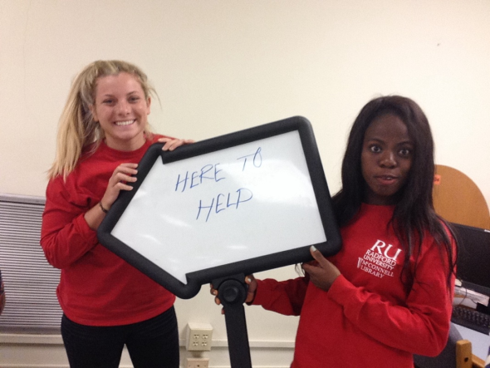
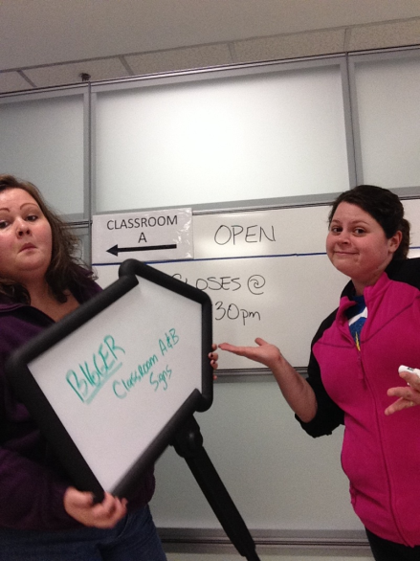
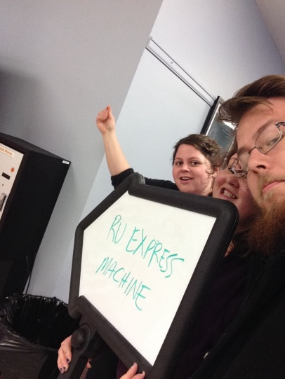
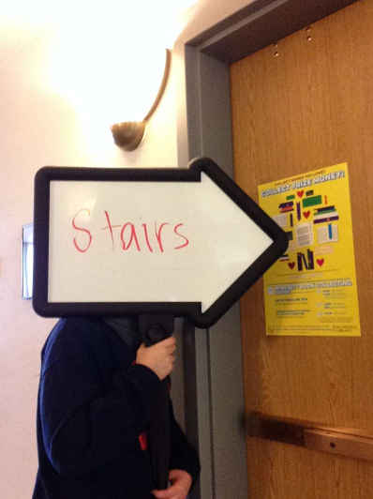
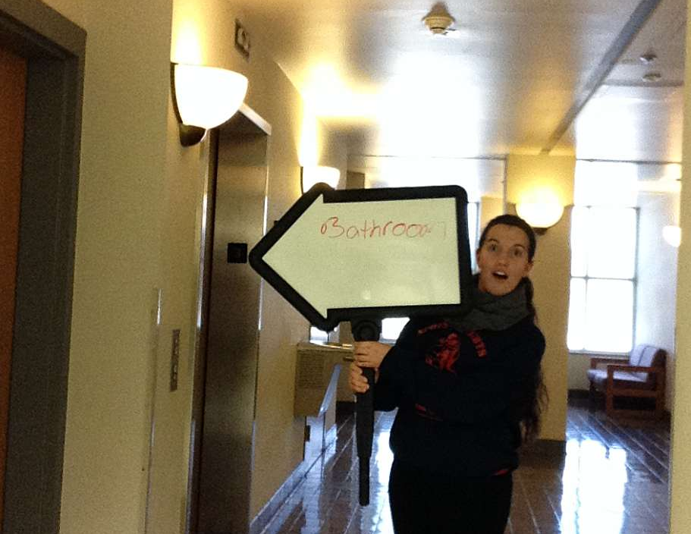
Signage
Notes:
Most recently, the library’s dean has identified a need for unified signage. We decided to use the advisory group to gain some knowledge of what and where signs should be located.

Slide 10
Best Practices
Relevant to the students
Make it fun
Meaningful to the library
Literature for ideas
Communicate with partners
Set expectations
Schedule time to debrief
Keep records
http://pixabay.com/en/thumb-up-best-thumb-hand-good-605738/

Slide 11
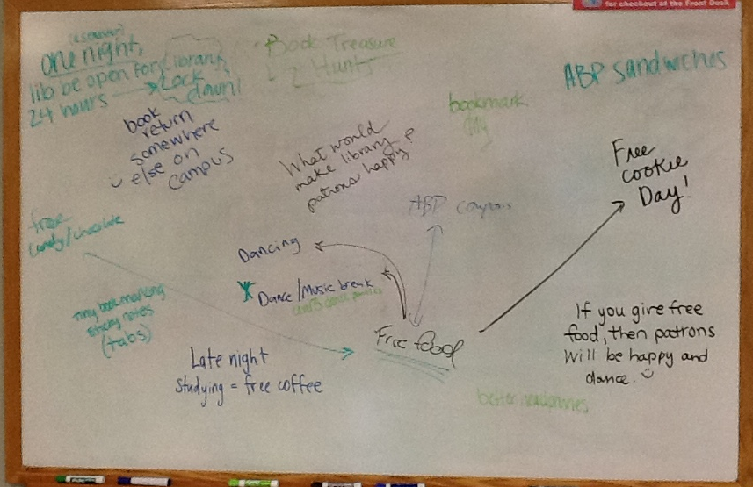
Thank You! Questions?
Dropbox Link to Presentation: http://bit.ly/1Jq6ot0
Contact information:
Alyssa Archer, Instruction Librarian, aarcher2@radford.edu
Craig Arthur, Instruction Librarian, carthur3@radford.edu
Beth Johnson, Head of Access Services and Coordinator of Student Engagement ejohnson82@radford.edu
Candice Benjes-Small, Head of Information Literacy and Faculty Outreach, cbsmall@radford.edu
Notes:
Open ended questions and feedback can still be helpful! Here’s some suggestions from our last meeting. Our Advisory Board has always been a valuable asset to our library, but making a stronger push to get feedback on concrete issues we needed students’ perspective on has helped tremendously.

